Slide 1

Blue Shield Keeping you Well
Wellvolution
Teladoc Behavioral Health
myStrength
© 2020 Blue Shield of California. All Rights Reserved.

Slide 2


Wellvolution is Blue Shield’s digital health care benefit available to BSC Members 18 years old or older
Wellvolution provides:
Digital health coaching
exercise & and nutrition advice
digital tools like weight scales and Fitbits to members who have a health risk.
Wellvolution also offers general well-being apps to help members who do not have a health risk remain healthy.
www.Wellvolution.com
Convenient, private and trusted programs available 24/7
Wellvolution
Best-in-class disease prevention and reversal platform

Slide 3
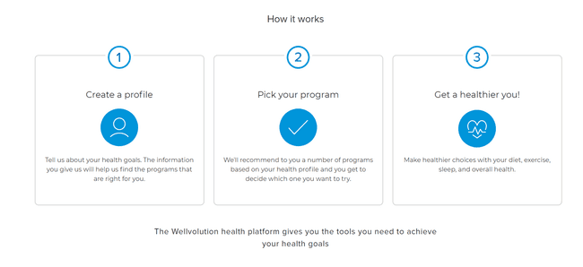
Enrollment is easy!
www.wellvolution.com
  Create an account with a password
  Enter member ID
  Answer a multiple-choice questionnaire of about 10-15 questions, confirm health goals and needs and the platform recommends a suitable program, or a provider based on health risks and goals.

Slide 4



Disease prevention and condition reversal programs
These programs are for at risk members in need of more support. All programs provide a free digital weight scale and 1:1 health coaching
Weight Watchers
Betr Health
Track food, water, sleep, activity, weight, plus a barcode scanner for easy shopping
Get 8,500+ recipes filtered by dietary needs, prep time, and more
Enjoy equipment-free virtual workouts you can do anytime, anywhere
Access curated Headspace® meditations
Stay supported with 24/7 Live Coaching from WW experts
Lose Weight (3-5 Pounds Per Week)
Reverse Diabetes, High Cholesterol, Hypertension
Relieve Anxiety, Cravings and Mental Fog
One on One Dedicated Daily Coach
24/7 Access to Physician Led Support Team
Virta:
Medical supervision from a licensed provider (MD, DO, NP, RN, or PA)
Unlimited support from a one-on-one health coach
All the diabetes testing supplies you need
Educational videos and resources like recipes and meal plans

Slide 5
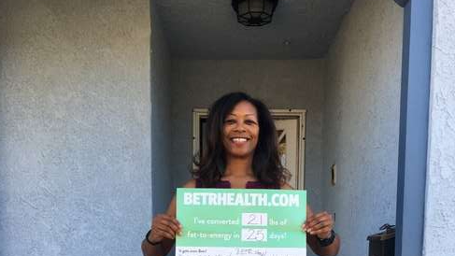
Abebi lost 21 lbs in 25 days with Digital Program Provider Betr Health
Abebi Bain, Elementary School Teacher
Wellvolution Provider: Betr Health
Health Improvements:
Weight loss of 21 lbs in 25 days
better sleep
complete elimination of medications,
pain reduction
“Down 21 pounds and keeping it off, and it has been so easy. I was on a lot of meds... acid reflux, asthma, allergy, and I am not taking anything now.
And I can enjoy all the foods that the doctors previously told me to avoid, like citrus, acidic foods, but now I can enjoy all of it in moderation and I sleep better and no longer snore.”

Slide 6

May is Mental Health Awareness Month
The mind is very fragile seek help with one of Blue Shield online digital/virtual programs.

Slide 7


Slide 8
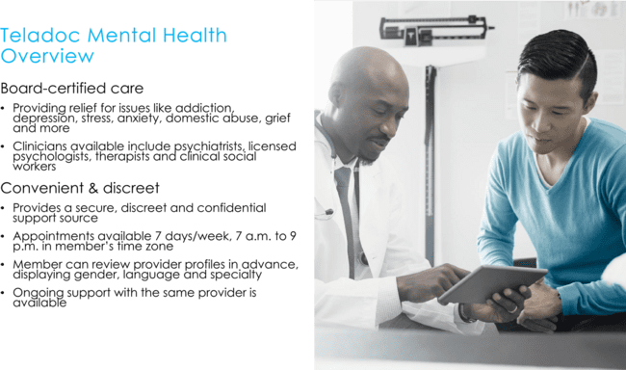

Slide 10

myStrength
Digital behavioral health solution
for Trio members
Empowering individuals
Self-service treatment tools empower individuals with engaging, clinically
proven resources
Integrated, guided experience
Highly interactive, personalized pathways address challenges like depression,
anxiety, stress, substance use, chronic pain, and insomnia
Evidence-based, clinically reviewed
Combines a range of proven, evidence-based models, like cognitive behavioral therapy, to improve and maintain resilience and well-being
Nurturing mind, body, & spirit
Supports physical and spiritual aspects of whole-person health, includes
wellness resources
Demonstrated value
83%
As effective as
face-to-face therapy
43%
Reduction in symptoms within
first 2 weeks of engagement
10
Notes:
Available to all fully insured Trio & Tandem members aged 13+ (buy-up for ASO)
Self-service tools through digital channels only
Easy entry point helping to remove any stigma
myStrength is a digital behavioral health solution that empowers individuals through engaging, clinically-proven resources. myStrength combines a broad range of evidence-based models and offers a daily destination for improving and maintaining overall well-being and resilience.
Integrated, guided experience
myStrength uses highly interactive, individually-tailored applications to help users address depression, anxiety, stress, substance use, chronic pain and sleep challenges, while also supporting the physical and spiritual aspects of whole-person health. myStrength adjusts each day and with every interaction. Preferences and goals, current emotional and motivational states, ongoing life events are all captured.
Self-service treatments include:
Depression
Interactive mood management program teaches cognitive behavioral therapy (CBT) in an engaging step-by-step approach.
Anxiety
Based in mindfulness and CBT, this program explores a range of in-the-moment coping skills to reduce panic now and prevent out-of-control worry in the future.
Stress
Core tenants of positive psychology and mindfulness shared in a practical context make this a powerful program for handling workplace or personal stress.
Substance Use
Based on readiness to change, this dynamic program builds awareness of usage patterns alongside in-depth CBT-based relapse prevention for a powerful recovery experience.
Chronic Pain
Peer-led program teaches coping strategies for coping with pain, managing opioid use and creating positive interactions with care teams.
Insomnia
Highly-engaging program based in CBTi, combines interactive tracking and individualized sleep plan to ensure a solid night's rest.
Evidence-based and clinically-reviewed
The myStrength experience is based in clinical models like cognitive behavioral therapy, acceptance and commitment therapy, positive psychology, mindfulness, and motivational interviewing – proven interventions that have helped millions improve and sustain health and well-being.
Nurturing mind, body and spirit
myStrength cultivates whole-person well-being. Clinically-reviewed wellness resources for diabetes, smoking cessation, nutrition, as well as user-defined inspirational and spiritual resources fill out the myStrength experience.
Demonstrated value
83% as effective as face-to-face therapy at a fraction of the cost*
43% symptom reduction within first two weeks of engagement*
*Schladweiler, K., Hirsch, A., Jones, E., Snow, L.B. (2017). Real-World Outcomes Associated with a Digital Self-Care Behavioral Health Platform. Annals of Clinical Research and Trials, 1(2), 007.

Slide 11

myStrength Completely Digital 24/7
Assistance with the following:
Depression
Anxiety
Stress
Substance use disorders
Chronic pain
Sleep challenges
© 2020 Blue Shield of California. All Rights Reserved.
11
Notes:
Pick those statements that fit the customer/client, based on previous conversations and RFP questions.

