Slide 1
Schools Insurance Group EBRC May 10, 2021 Wellness Spotlight

Slide 2
Behavioral Health
Mental health, behavioral health and substance use disorder (MH/SUD) services provided by U.S. Behavioral Health Plan, California (USBHPC)
Members do not need a referral for office visits and can search for providers directly through USBHPC
Appointments available in-person or through secure virtual visits with select providers
Visit sutterhealthplus.org/providersearch and navigate to Behavioral Health under Plan Partners
Members also have access to Sanvello—an app that offers on-demand help for stress, anxiety and depression—at no cost.

Slide 3
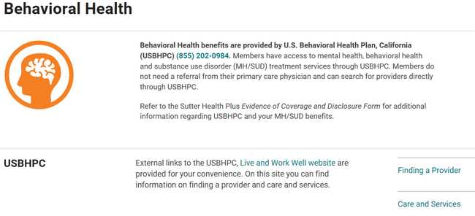
How to find a mental health provider: https://provider.liveandworkwell.com/content/laww/providersearch/en/home.html?siteId=9083&lang=1

Slide 4
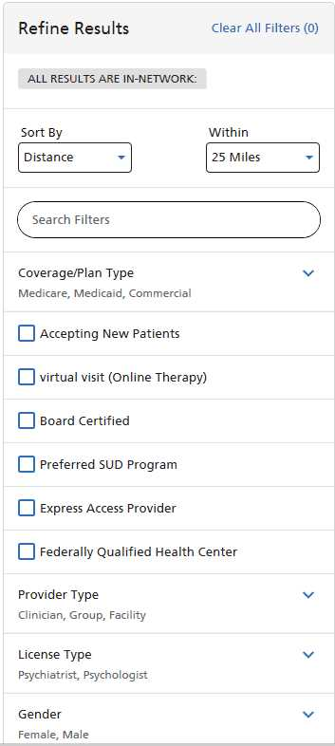
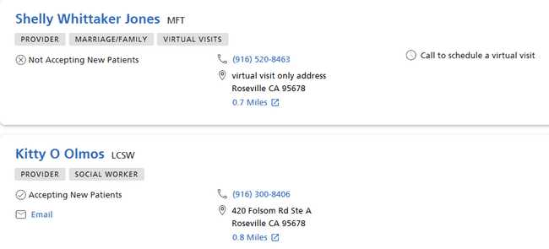
Refine your search using filters:

Slide 5
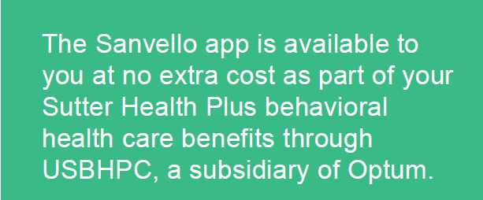
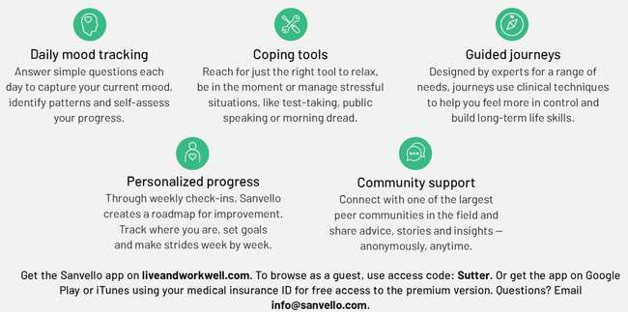
Sanvello application

Slide 6
Sutter Health Plus Health and Wellness
Health Coaching Program for healthy weight, tobacco cessation and stress management
Integrated Care Management for heart failure and diabetes
Health and Wellness site including a personal health assessment and 12 action plan modules
24/7 Nurse Advice Line for medical questions or concerns to help members determine the right level of care
Wellness Page for health and wellness tip sheets, health maintenance guidelines, and live and recorded webinars
Learn more at sutterhealthplus.org/wellness
Notes:
The Health Coaching Program and Disease Management Program are both telephonic programs.

Slide 7
Health Coaching Program
One-on-one telephonic personal health coaching for:
Healthy weight
Stress management
Tobacco cessation
Call 866.961.8513 to learn more

Slide 8
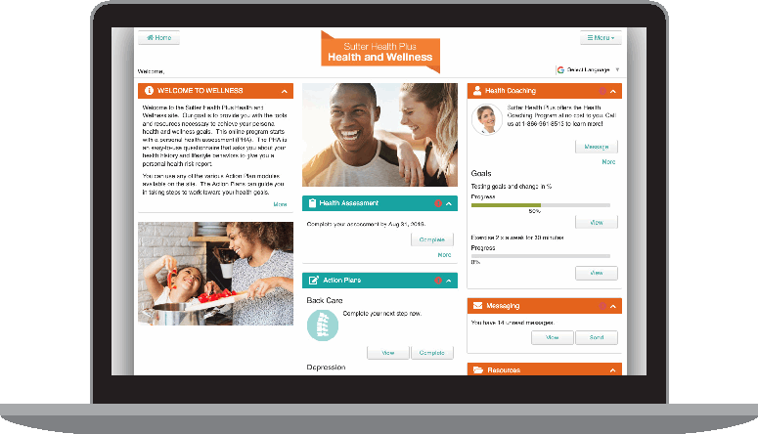
Health and Wellness Site
Personal health assessment
English and Spanish
12 Action Plan modules
Healthy Eating, Stress Management, Heart
Disease Prevention and more
Health Library
Learning Centers, a Video Library and a
Symptom Checker
Health Decision Tools
Designed to guide members through
key health decisions, combining medical
information with personal values to make
health decisions
Accessed through the Member Portal at shplus.org/memberportal

Slide 9
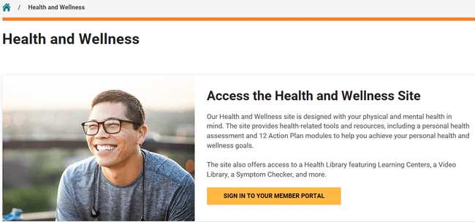
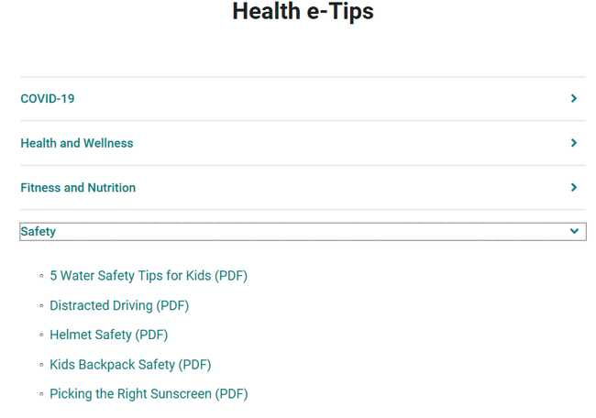
Sutter Health Plus website for member wellness

Slide 10
Examples of past webinars and Health e-Tips

Slide 11
Nurse Advice Line
24/7 telephone access to registered nurses for medical questions or concerns
Helps determine the right level of care for a member’s health needs
Provides home care tips for minor injuries and illnesses

Slide 12
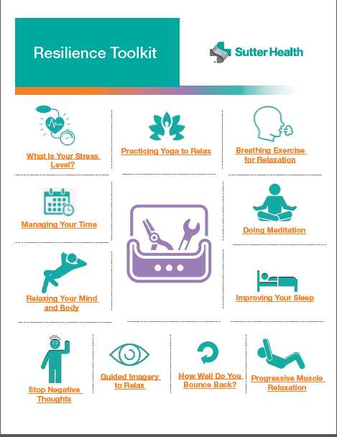
A beautiful day begins with a beautiful mindset, take time and enjoy this Resilience Toolkit!
https://www.sutteremployer.org/pdf/sutterebi/resilience-toolkit.pdf

