Slide 1
WHA Wellness Resources Summer 2021

Slide 2
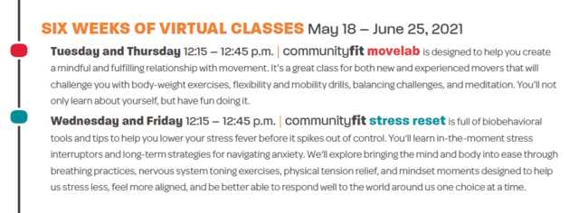
communityFIT

Slide 3
MyWHAWellness
Notes:
What is the first thing the comes to mind when you hear the word “Diet”
Definitions:
The kinds of food that a person, animal, or community habitually eats
And a special course of food to which one restricts oneself, either to lose weight or for medical reasons
Diet as your common nutrition
Diet as in “Being on a diet”

Slide 4
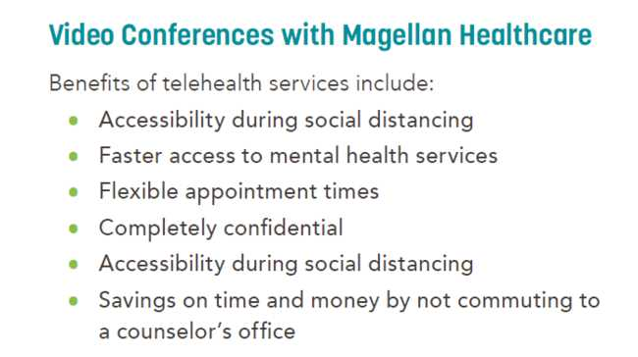
Magellan Behavioral Health

Slide 5
RESTORE®

